Slide 1
CUSTOMER CHURN ANALYSIS
Prepared by: Azeemah Sullayman AnalystLab Africa Internship – Week 5

Slide 2
Business Problem
Customer churn is one of the biggest challenges faced by telecommunication companies. Losing customers results in reduced revenue, higher customer acquisition costs, and lower long-term profitability.
This project analyzes customer behavior to identify the key drivers of churn and provides data-driven recommendations to improve customer retention.

Slide 3
Dataset Overview
Dataset: Telco Customer Churn Dataset
Source: Kaggle
Dataset Size:
• 7,043 Customers
• 21 Features
Fields include customer demographics, services subscribed, contract type, payment method, monthly charges, total charges, tenure, and churn status.
Tools Used:
Python
Power BI
Pandas
Matplotlib

Slide 4
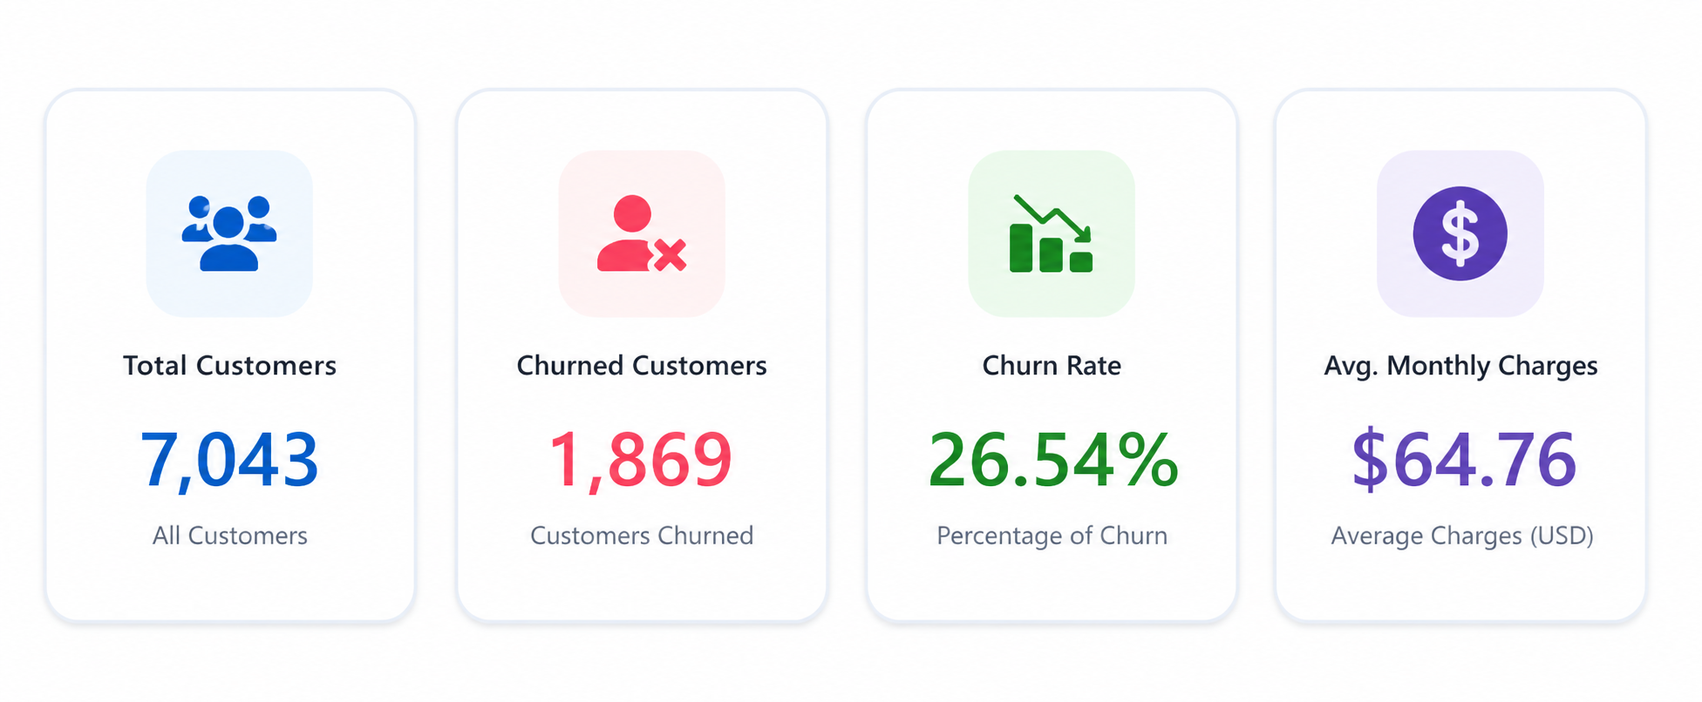
KPIs Defined
KPIs Defined
Total Customers: 7,043
Churned Customers: 1,869
Churn Rate: 26.54%
Average Monthly Charges: $64.76

Slide 5
Dashboard Overview
Interactive Features:
• Contract Type Filter
• Internet Service Filter
• Payment Method Filter
• Customer Demographics
Visuals Included:
• Customer Churn Distribution
• Churn by Contract Type
• Churn by Internet Service
• Customer Tenure Distribution
• Average Monthly Charges by Churn
• Senior Citizen vs Churn
• Gender vs Churn
• Partner & Dependents Analysis

Slide 6
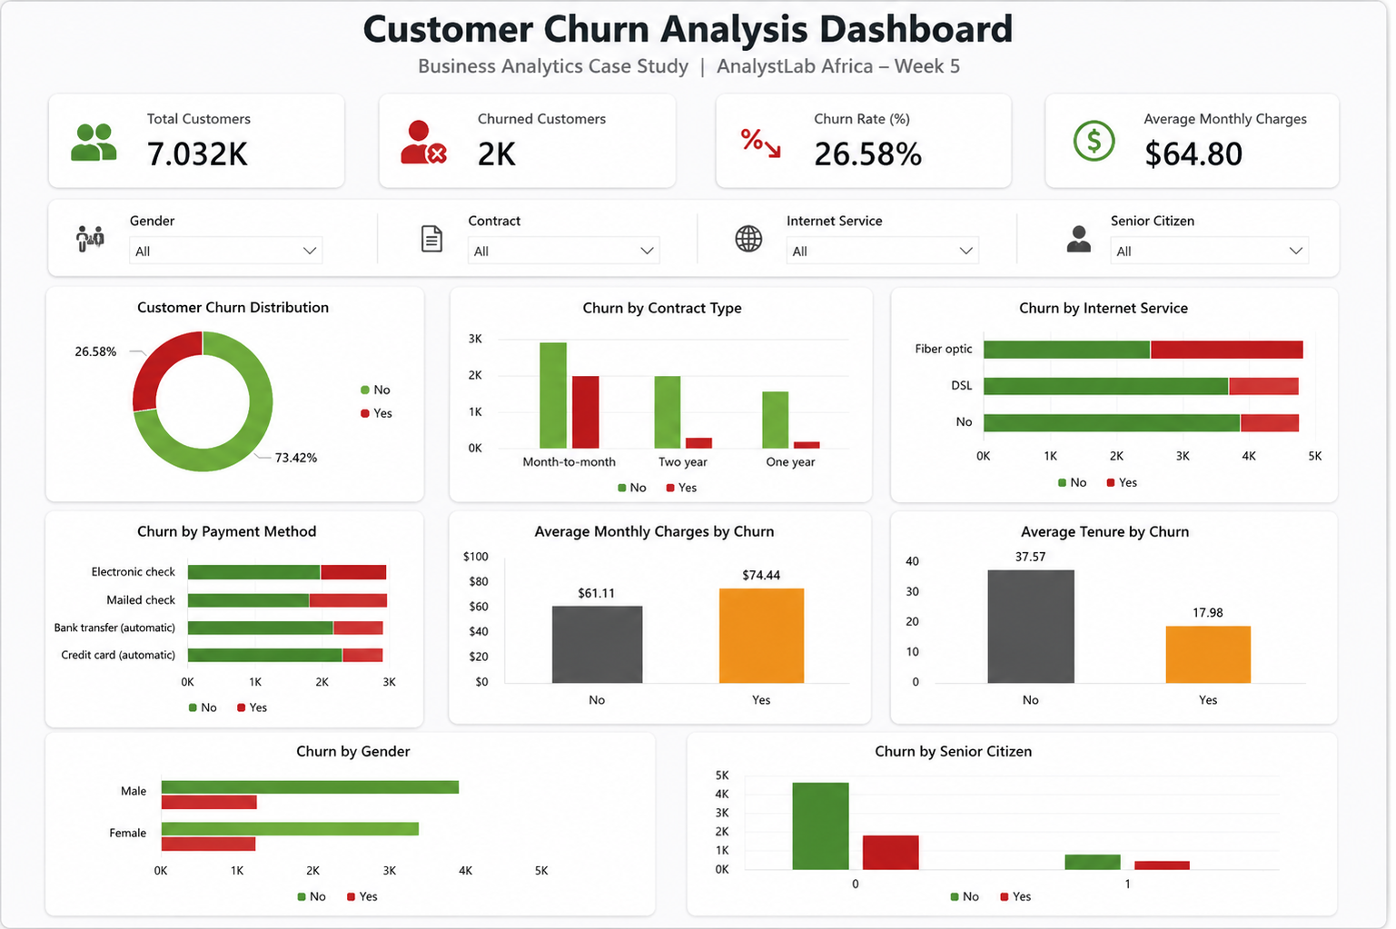
FULL DASHBOARD

Slide 7
Key Insights
Month-to-month contracts recorded the highest customer churn.
Fiber optic customers experienced higher churn than DSL customers.
Customers with shorter tenure were significantly more likely to leave.
Customers with higher monthly charges showed a greater likelihood of churning.
Senior citizens exhibited a relatively higher churn rate than non-senior customers.

Slide 8
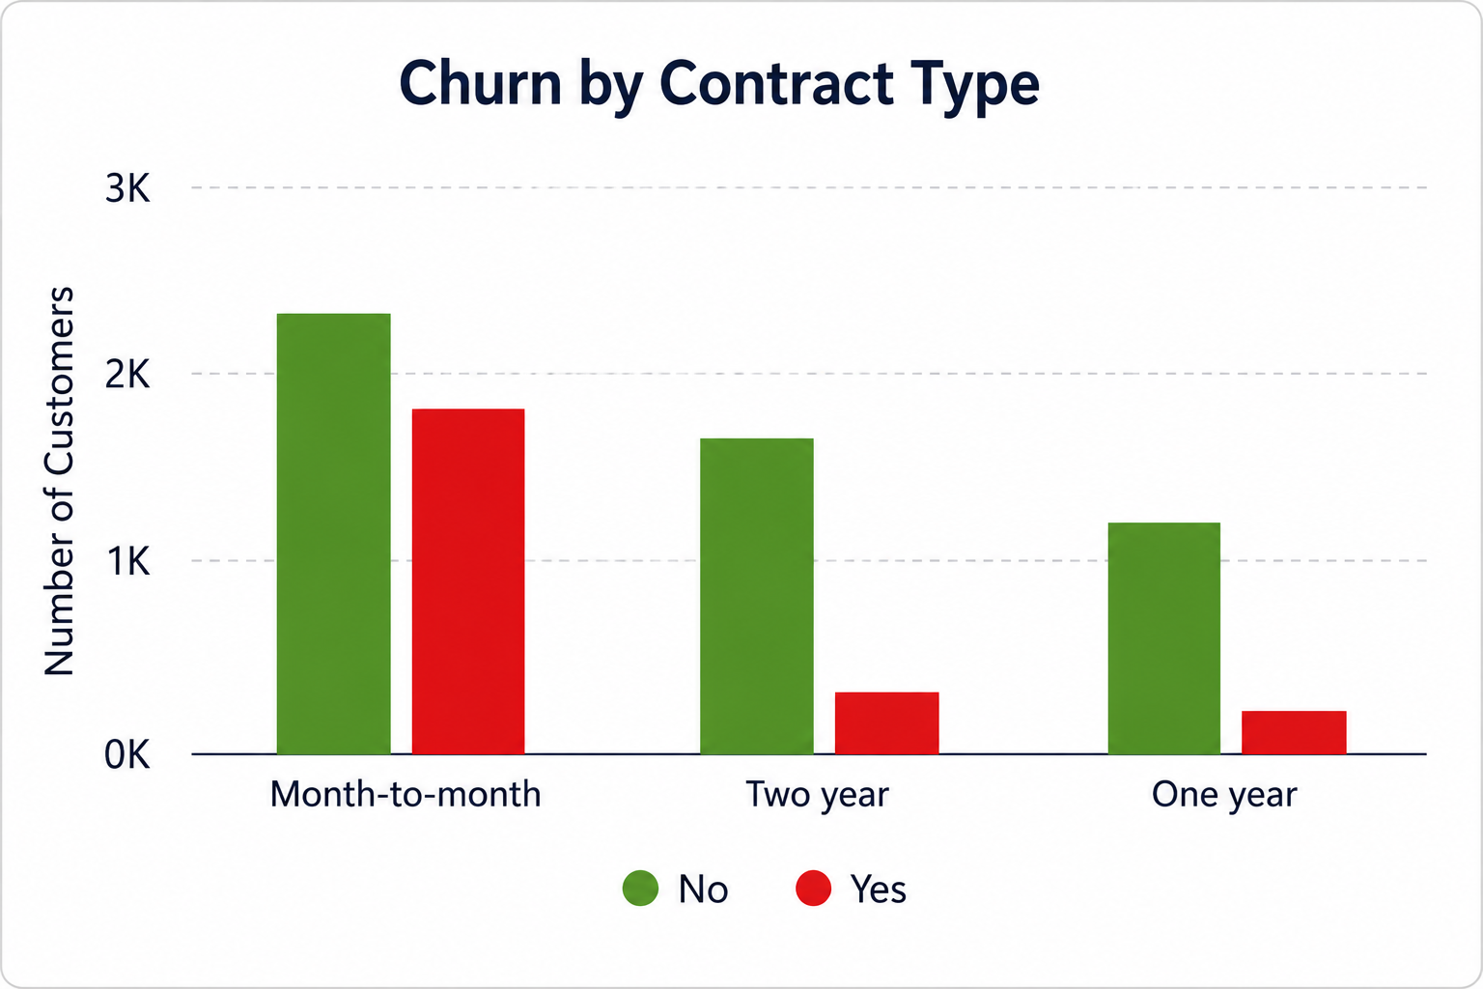
Churn by Contract Type

Slide 9
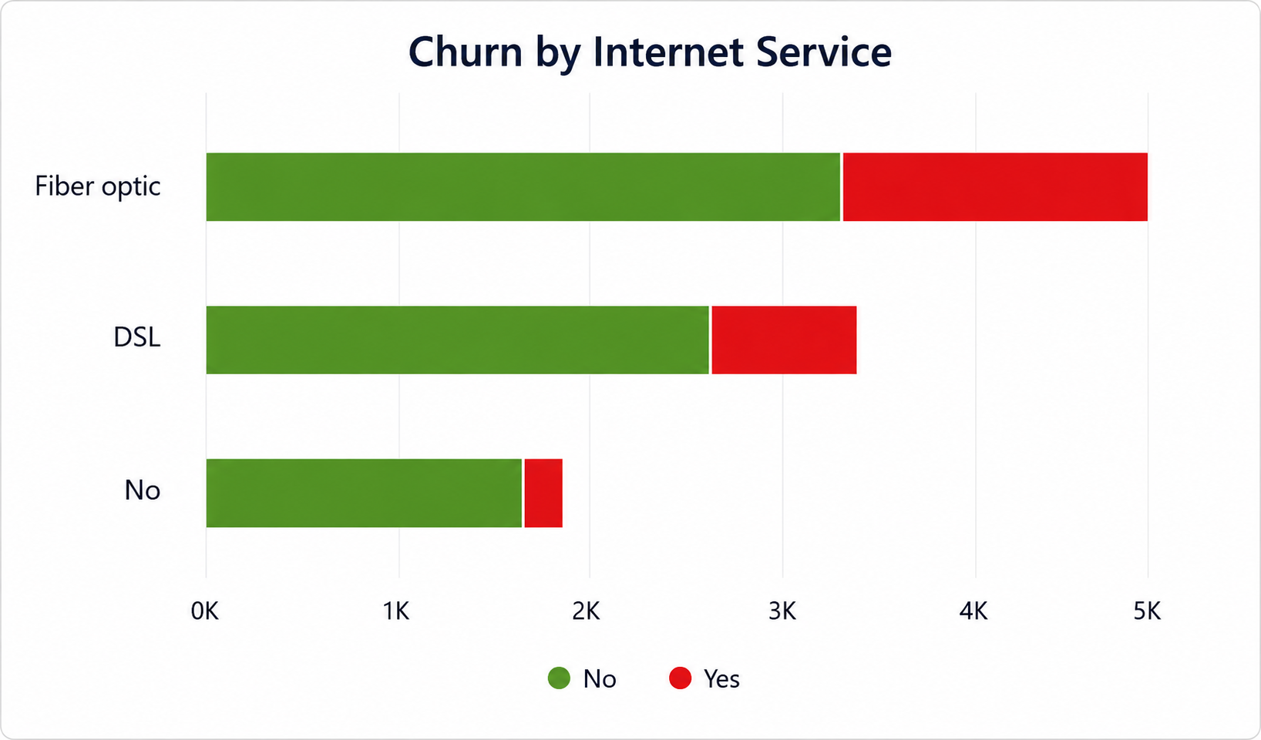
Churn by Internet Service

Slide 10
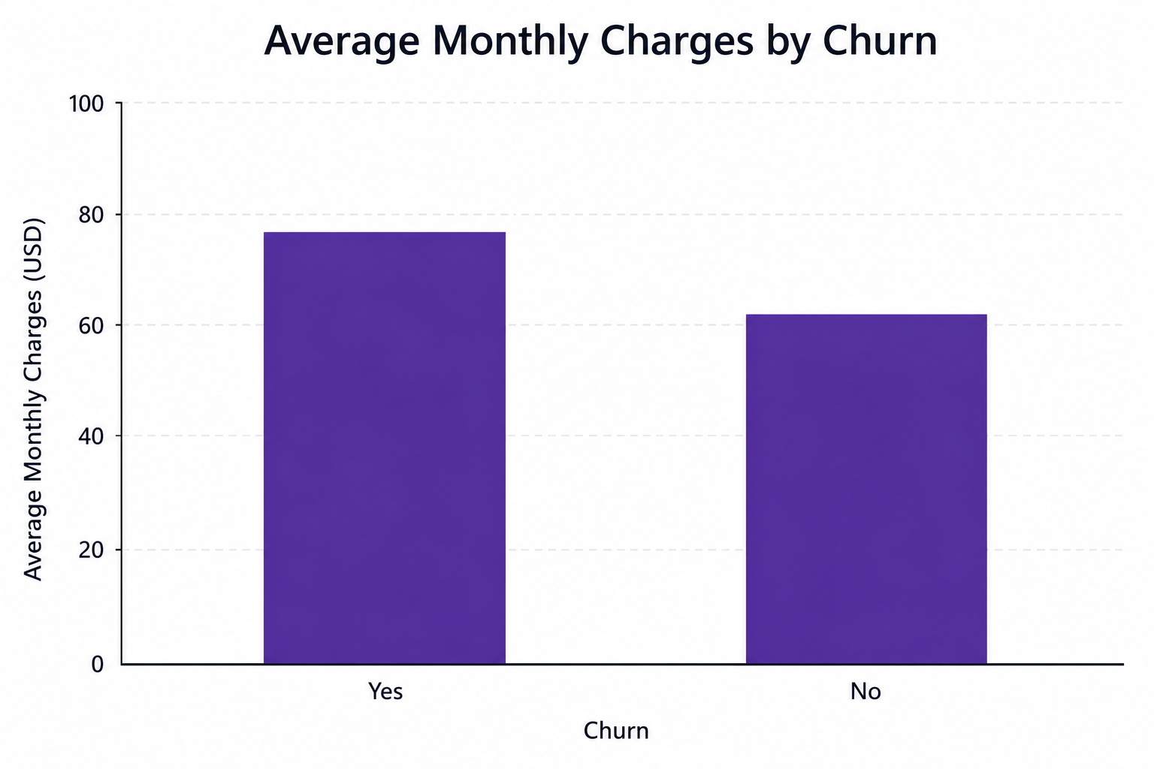
Average Monthly Charges by Churn

Slide 11
Recommendations
Encourage customers to migrate to long-term contracts through targeted incentives.
Improve customer retention strategies for Fiber Optic subscribers.
Strengthen customer engagement during the first year of service.
Introduce loyalty rewards for high-risk customer segments.
Continuously monitor churn trends using interactive dashboards.

Slide 12
Conclusion
The Customer Churn Dashboard transformed raw customer data into meaningful business insights.
The analysis identified the key factors influencing customer churn and provided practical recommendations that can support customer retention and improve business performance through data-driven decision-making.

